Slide 1
Performance Regression Testing with ReFrame – Introduction
ADVANCED RESEARCH COMPUTING
Tuomas Koskela¹, Ilektra Christidi¹, Mose Giordano¹, Emily Dubrovska¹
¹Advanced Research Computing Centre, UCL

Slide 2
Agenda
Introduction | 9:00 - 9:30
Automating benchmarks with ReFrame | 9:30 - 10:00
BREAK | 10 mins
Automating benchmarks with ReFrame (cntd) | 10:10 - 10:40
Automating builds with excalibur-tests | 10:40 - 11:00
BREAK | 10 mins
Analysis and visualisation | 11:10 - 12:00
BREAK for lunch | 12:00 - 13:00
Hands on | 13:00 - 15:45
Wrap-up | 15:45 - 16:00

Slide 3
Summary
It’s important to understand how our applications perform on different HPC architectures in order to make informed decisions about future systems and future software
Benchmarking, as it’s traditionally done, requires a lot of manual effort, is time-consuming, error prone and difficult to reproduce
Tools exist in the community to automate the manual effort – recording and documenting in the process.
We’ve developed a framework using Spack and ReFrame to automate portable building and running of benchmarks.
There is an initial price to pay, but the increase in productivity should be worth it! More collaborators are welcome.

Slide 4
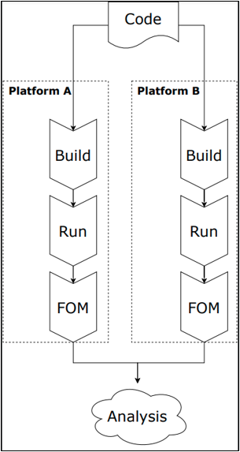
The Difficulty With Benchmarking
Benchmarking superficially means simply running a code and reporting its runtime – How hard can that be?
There are many free parameters on a HPC platform – Reproducibility is hard
Processors
Compilers
Software libraries
Build options
Runtime options
Performance metrics

Slide 5
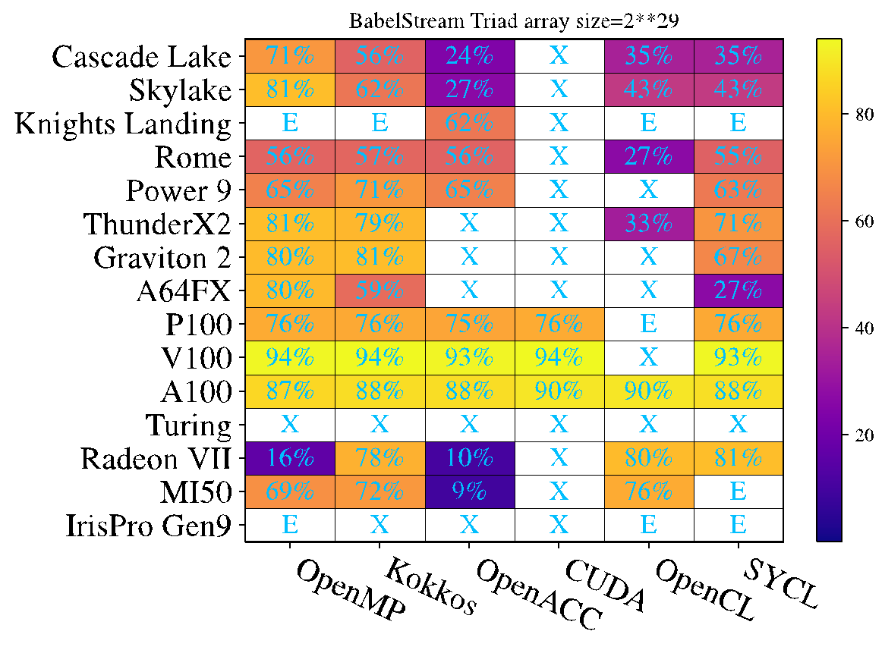

Architectural efficiency
From https://doi.org/10.1109/P3HPC51967.2020.00006

Slide 6
Building Blocks of a Reproducible Benchmarking Workflow
Select a benchmark
Select best build parameters on each platform
Rebuild benchmarks frequently
Capture build steps
Measure a figure of merit
Capture run steps
Analyse data
Curate results

Slide 7


Tools for automating (the middle bit)
Select a benchmark → community
Select best build parameters on each platform → spack
Rebuild benchmarks frequently → spack
Capture build steps → spack/ReFrame
Measure a figure of merit → ReFrame
Capture run steps → ReFrame
Analyse data → pandas/bokeh
Curate the results → community
https://github.com/ukri-excalibur/excalibur-tests

Slide 8

Using ReFrame for running performance benchmarks
github.com/reframe-hpc/reframe
Framework for regression tests and benchmarks for HPC systems
From CSCS and ETH Zurich
Python interface to write benchmarks in a declarative way
Abstracts interactions with the scheduler and build system
Tailored for HPC systems
Supports multidimensional test parametrisation
Supports many build systems, integrates with spack
Does performance logging

Slide 9

Using Spack for building benchmarks
Spack manages dependencies and automates builds
Developed in US national labs, used heavily in ECP
Supports a variety of build systems
Packages are parameterized
Build steps are recorded
Maintains a repository of build recipes
Customizable virtual environments
Flexible python interface
Easy to install and run with user permissions
github.com/spack/spack

Slide 10

ExCALIBUR Portable Benchmarking Framework
Framework for automating builds, runs and data collection of application benchmarks across HPC systems
It contains
ReFrame configuration and Spack environments for UK HPC systems
Benchmark applications for scientific use cases
Analysis and Visualisation tools
Documentation and Tutorials
Packaging

Slide 11
Agenda
Introduction | 9:00 - 9:30
Automating benchmarks with ReFrame | 9:30 - 10:00
BREAK | 10 mins
Automating benchmarks with ReFrame (cntd) | 10:10 - 10:40
Automating builds with excalibur-tests | 10:40 - 11:00
BREAK | 10 mins
Analysis and visualisation | 11:10 - 12:00
BREAK for lunch | 12:00 - 13:00
Hands on | 13:00 - 15:45
Wrap-up | 15:45 - 16:00

Slide 12
Links
GitHub
https://github.com/ukri-excalibur/excalibur-tests
Website https://ukri-excalibur.github.io/excalibur-tests/
Connecting to Archer2
https://docs.archer2.ac.uk/user-guide/connecting
Spack
https://spack-tutorial.readthedocs.io/en/latest/
ReFrame
https://reframe-hpc.readthedocs.io/en/latest/

Slide 13
Instructions for the afternoon
Some options:
Write a benchmark of your favourite code, using either
ReFrame with your build system or
the excalibur-test framework, if you already have a spack recipe
Explore the rest of the ReFrame tutorials
If you’re feeling adventurous, start writing a spack recipe for your benchmark!
Join the #reframe slack channel for assistance and discussions

